Slide 1



In-situ Oxygen Production on Mars
Bharath Tata and Dr. Klaus Lackner
Center for Negative Carbon Emissions
School of Sustainable Engineering and the Built Environment

Slide 2
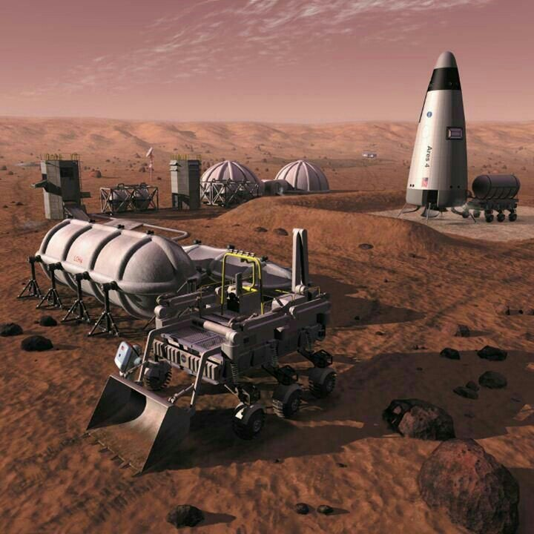
What is ISRU?
Living off the land
Essential for sample-return and manned missions
Produces:
  Food
  Water
  Fuel
  Oxygen
  Building Materials
Image: Pat Rawlings/NASA

Slide 3
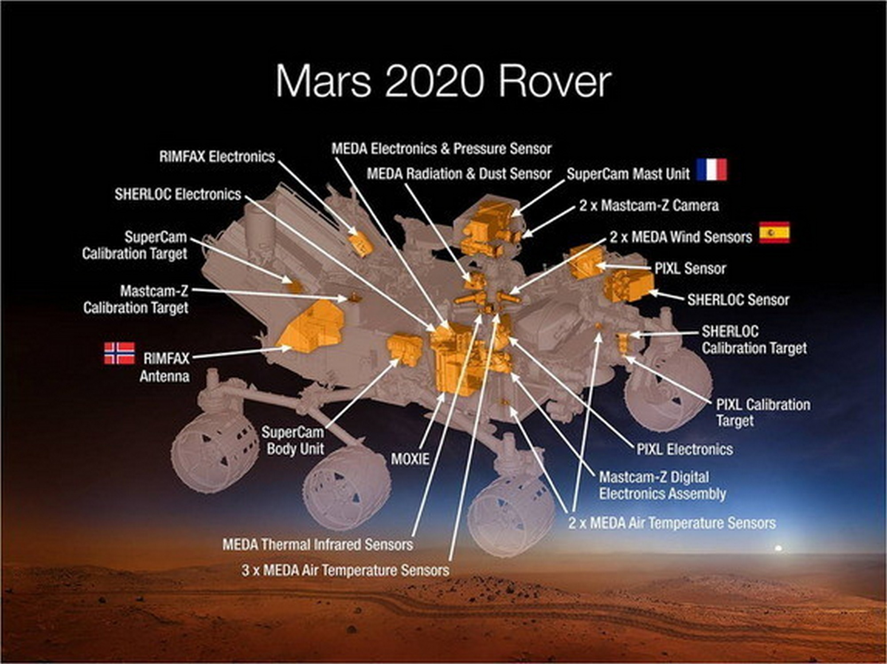
Conducting science on the surface
Drilling
Resource prospecting
Sample collection and storage
Testing of ISRU technologies

Slide 4
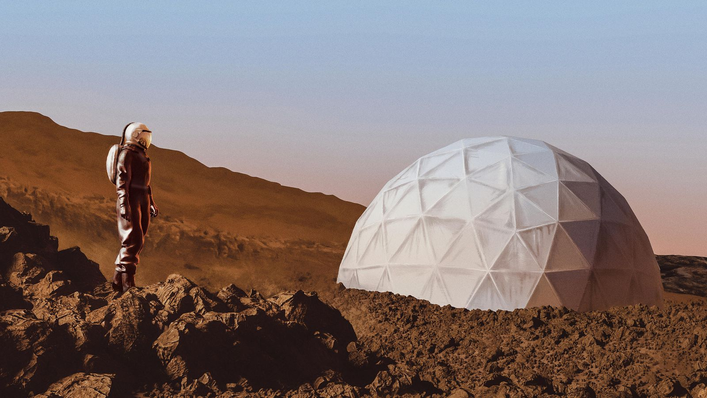
MOXIE
Mars OXygen In-situ resource utilization Experiment
Image: Chris Skinner

Slide 5
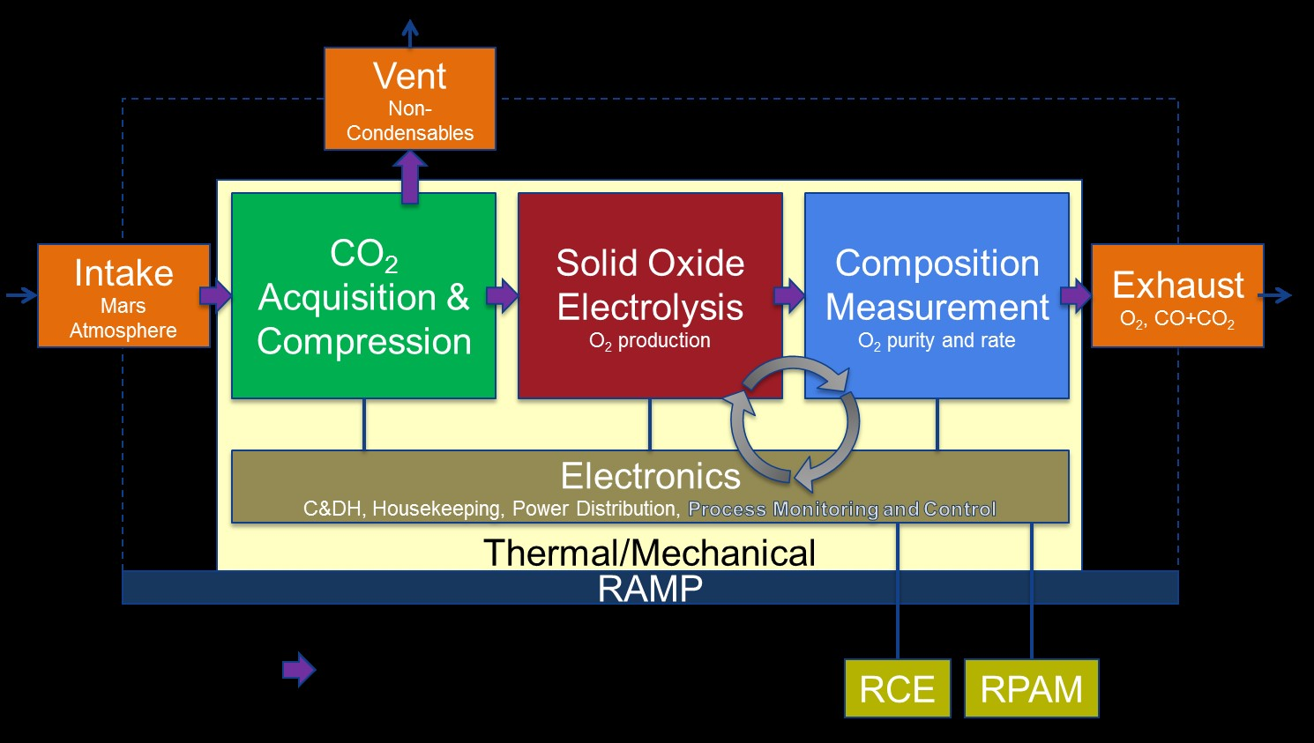
MOXIE
Image: NASA/JPL-Caltech/MIT

Slide 6

Issues
High energy demand
High compression ratio required
Low scroll compressor efficiency
Poorly understood heat transfer at inlet
  How much does the gas warm up?
  What factors affect this?
  What is the resulting density of the gas at the compressor inlet?
https://upload.wikimedia.org/wikipedia/commons/3/31/Two_moving_spirals_scroll_pump.gif

Slide 7
Proposed changes
Reduction in SOXE inlet pressure
Electrostatic dust filtration
Two compressors in series
Strategies to adjust efficiency of compressors
  High density inlet (cold)
  Jacketed tubing
  Relocation of compression unit to upstream side of filter

Slide 8
Continuing Research
Optimizing SOXE for operation at low pressures
Evaluating pressure drop across the filter over larger timescales
Scale-up

